Slide 1
Metadata for the St. John’s University Insurance Receipt Collection
Sharell Walker
11/16/2013

Slide 2

The Kathryn and Shelby Cullom Davis Library
Kathryn and Shelby Cullom Davis Library, part of St. John’s University’s School of Risk Management
According to their website “today, the Davis Library remains one of the most comprehensive risk, insurance, and actuarial science collections in the world” (St. John’s University, 2013).
http://www.stjohns.edu/academics/libraries/campus/davis

Slide 3
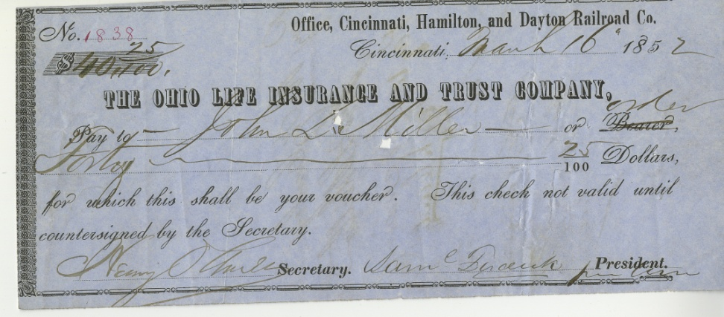
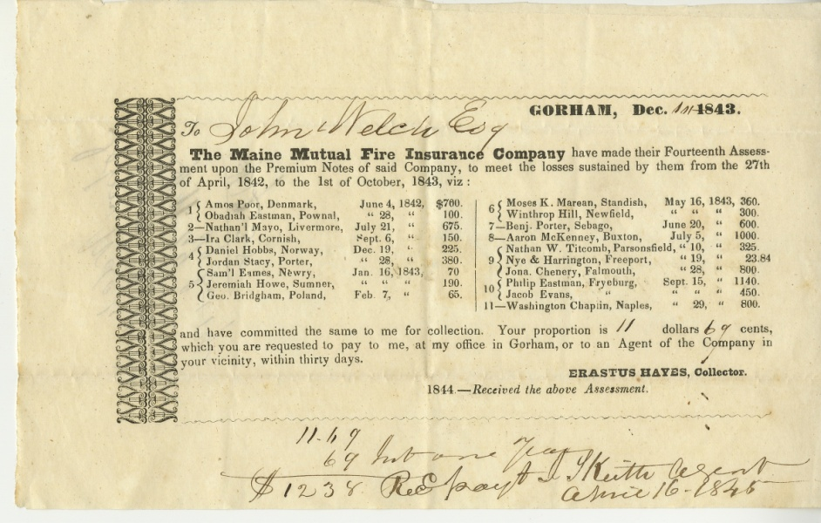
The Collection
Collection of receipts largely from the 1800’s.
Benefits to the Davis Library and the scholars who use the library.

Slide 4
The Metadata
Metadata Elements Needed | Explanation and Description of Metadata | Example | Implementation
Company | The name of the insurance company the policy is with | Smith Insurance Company | M,R
Date | The date on the insurance receipt | December 1843 | M
Client/Policy Holder | The name of the client listed on the receipt/to whom the receipt or policy is made out to | Dan Brown | O
Salesman/Insurance Adjuster | Name of the company representative who is identified on the receipt | John Smith | O
Policy Description | Brief overview of the policy and the amount paid | Assessment of losses sustained; $1,000 | M
Identifier | Identifying Number | ######## | M
Language | Language receipt is written in | English | M
Related Artifacts | Connected Documents; connected insurance policies | None | O
Type | Type of Insurance | Fire Insurance | M
Note | Special Cataloger Note | Receipt in poor condition | O
Rights | Rights of who can access receipt | St. John's University | M
Title | Title | Smith Insurance Payment | M,R
Current Situation
Metadata Needs
  Searching and retrieval
  Internet access
Identified Elements

Slide 5
The Methodology and Application
Metadata Elements Needed | Dublin Core | MODS Lite
Company | Publisher | Origin Info
Date | Date | Origin Info
Client/Policy Holder | Contributor | Name
Salesman/Insurance Adjuster | Creator | Name
Policy Description | Description | Abstract/Note/Table of Contents
Identifier | Identifier | Identifier
Language | Language | Language
Related Artifacts | Relation | Related item
Type | Type | Type of Resource
Note | sju.Note | Note
Rights | Rights | Access Condition
Title | Title | Title Info
Matching the Metadata Needs
Dublin Core
  Properties
MODS Lite
  Properties
Library of Congress, 2012

Slide 6
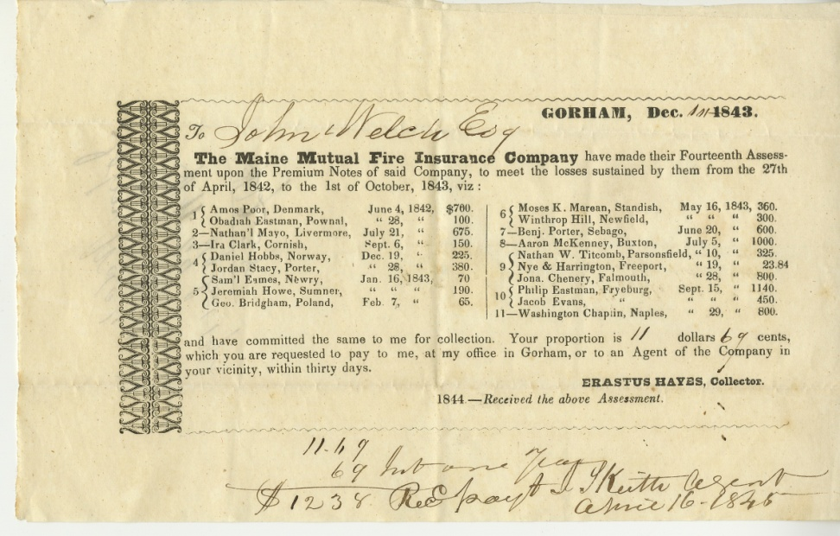
Dublin Core Application
Metadata Need | Dublin Core
Company | Publisher | The Maine Mutual Fire Insurance Company
Date | Date | December 1843
Client/Policy Holder | Contributor | John Welch Esq.
Salesman/Insurance Adjuster | Creator | Erastus Hayes
Policy Description | Description | Assessment of losses sustained; $12.34
Identifier | Identifier | #######
Language | Language | English
Related Artifacts | Relation | None
Type | Type | Fire Insurance
Note | sju.Note | None
Rights | Rights | St. John's University
Title | Title | Maine Mutual Fire Assessment

Slide 7
MODS Lite Application
Metadata Need | MODS | ?
Company | Origin Info | ?
Date | Origin Info | ?
Client/Policy Holder | Name | ?
Salesman/Insurance Adjuster | Name | ?
Policy Description | Abstract/Note/Table of Contents | Assessment of losses sustained
Identifier | Identifier | ######
Language | Language | English
Related Artifacts | Related item | None
Type | Type of Resource | Print, Fire Insurance
Note | Note | None
Rights | Access Condition | St. John's University
Title | Title Info | Maine Mutual Fire Assessment

Slide 8
The Future
Further Testing
  Digitization
  Expansion of Metadata
*Information and Images property of St. John’s University

